Slide 1

Education through collaborating on real world problems
https://omdena.com/chapters/

Slide 2
Agenda
Review Problem Statement
Problem Statement
Project Goals
Roadmap and next steps
Task status
Task 1: Nica Medrano and Bhushan Chougule
Task 2: TBD
Task 3: TBD
Q&A

Slide 3
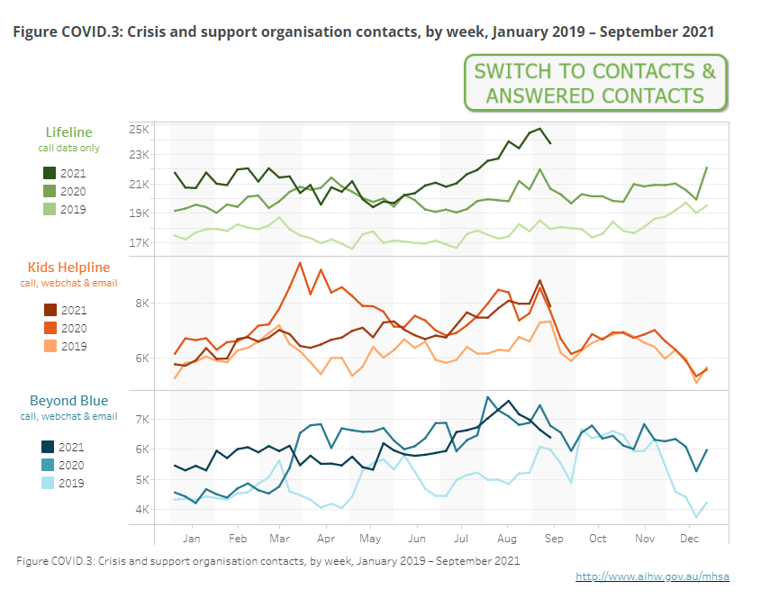
The Problem
COVID-19 had a big impact on the mental health of people all around the world.
In Australia, the mental health issues have escalated. Some statistics from the government are here.
The objective is to scope out a better way to create habits for general well-being.

Slide 4
The Project Goals
Scope out mental health issues in Australia
Identify 3 key steps to maintaining general well-being
Build a prototype chatbot/web-app to help people maintain a routine for general well-being
Test that prototype for user-experience
Vet the chatbot through proper channels

Slide 5
Collaboration
Bottom up development approach
Collaborators invited: 97
Weekly active collaboration: 45%
Meetings
Weekly meetings: Friday 7:30 PM Sydney (AEDT)
Task level meetings: As needed organised by Task lead
Workshops
BERT and Transformers for NLP
Streamlit – ML Model deployment

Slide 6

Timeline
Duration
4 weeks: 7th Jan to 4th Feb
Task 1: Data collection
Task 2: Analysis
Task 4:Modelling
Task 6:Integration
Task 3: Research
Task 5: Chatbot
Task 7:Deploy
Week 1
Week 2
Week 3
Week 4
Future Work
Workshop 1: NLP
Workshop 2 : Streamlit
Notes:
Mention about observers and participants

Slide 7



Task 1 [User need analysis and Data collection]
Data Collection
What has been done so far
subtasks have been assigned to groups of volunteers and are actively working on scraping/researching for data to be used for analysis
some of the subtasks are twitter, youtube, reddit, news scraping, official dataset research and analysis, chatbot dataset research
What’s remaining to be done
finalize data gathered for each subtask
Blockers
To decide on the ultimate goal for data collection which would depend on the type of chatbot we would make

Slide 8

Task 2
Data Analysis
Planning
Define questions to address
Habit analysis and relation to mental health
Execution
Descriptive data analysis
Extract data insights (e.g. sentiment analysis, empath analysis)
Data Relevancy for ML Model Building
Filter out data for those relevant to model building
Pre-processing data for ML Model

Slide 9
Task 3
Research documentation
Literature reviews
mental health management
Draft outline https://docs.google.com/document/d/1BsVzGgOx6MdhaskS-0PFMeU9WFj4Ut18/edit

Slide 10
Q&A
DATE
PROJECT / TASK

